Slide 1

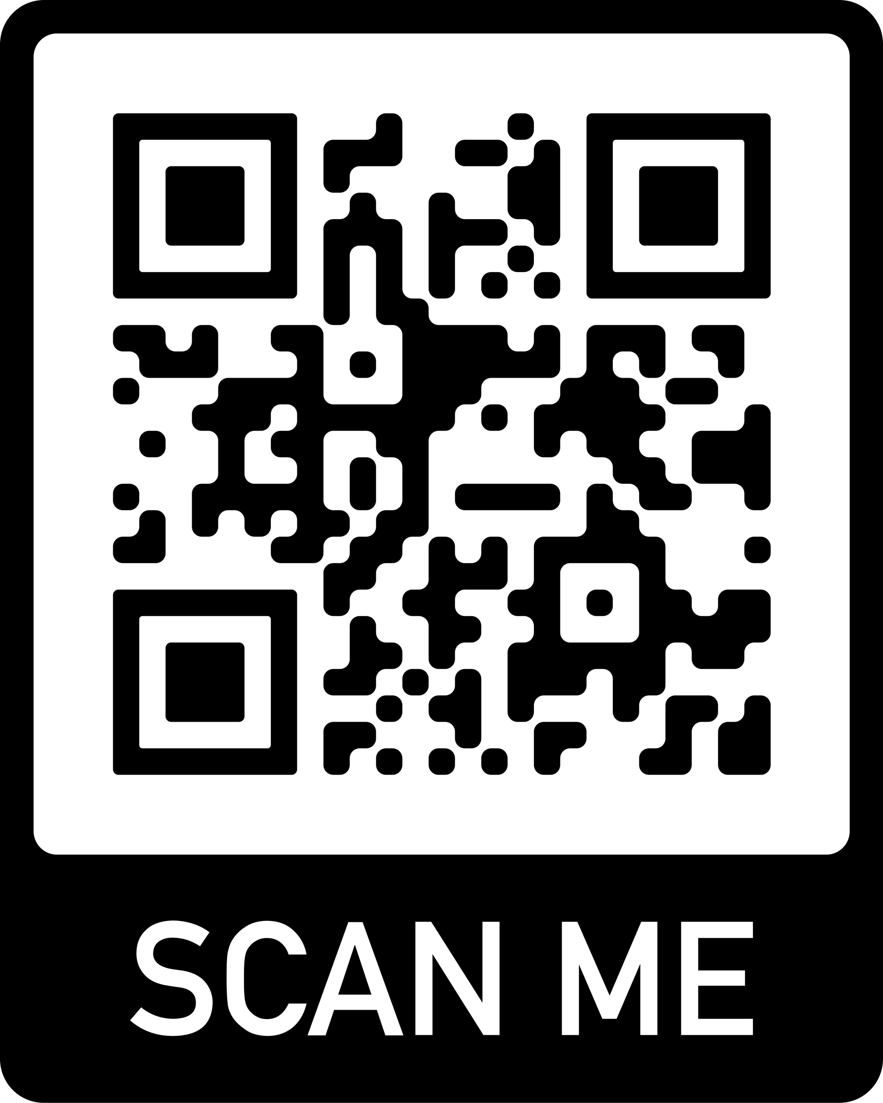

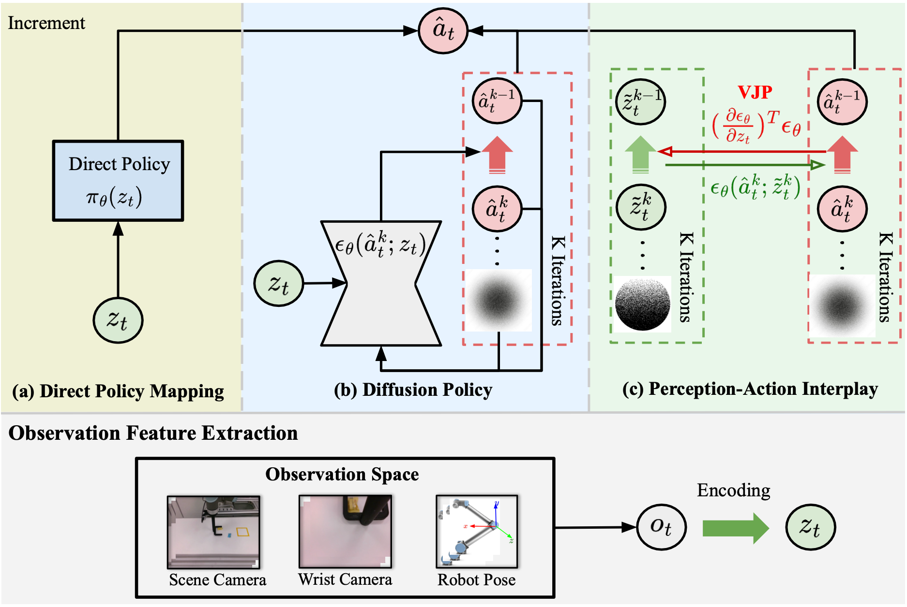
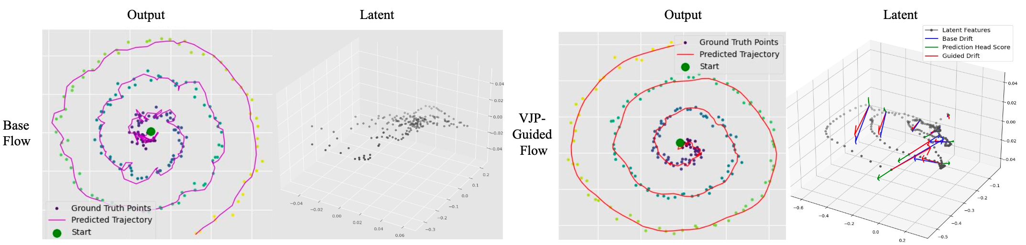
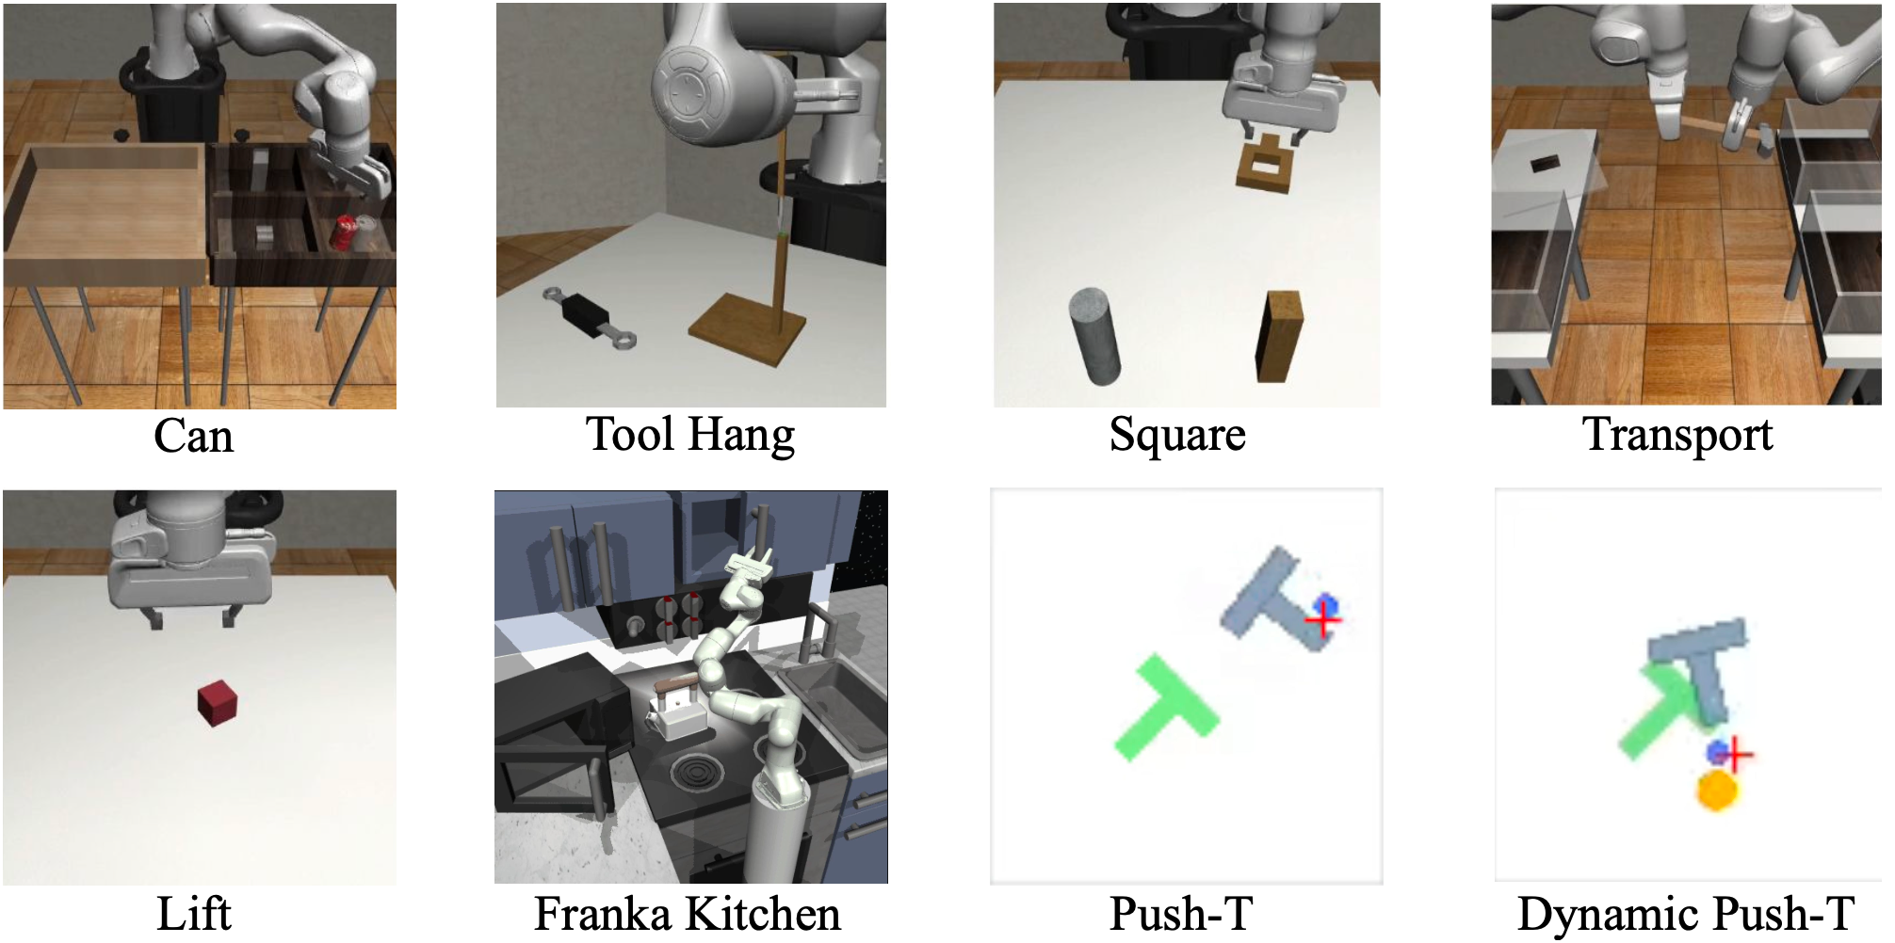
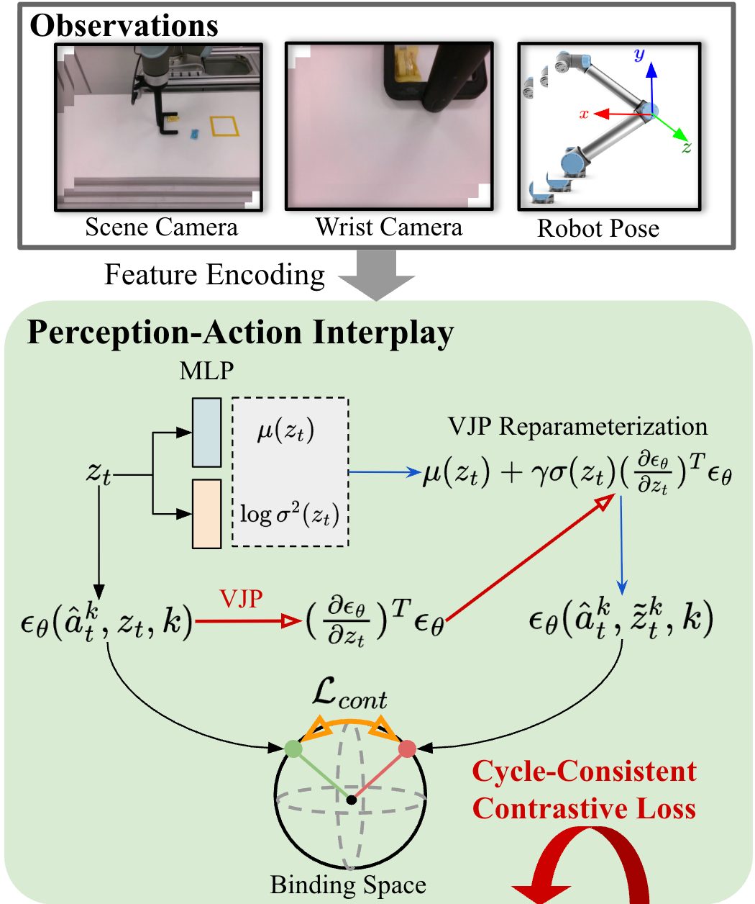

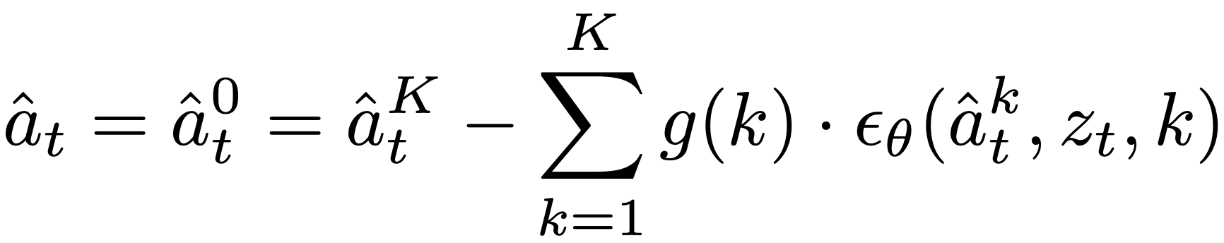
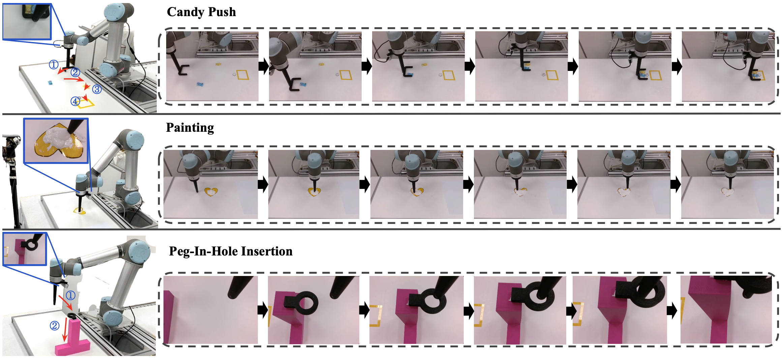
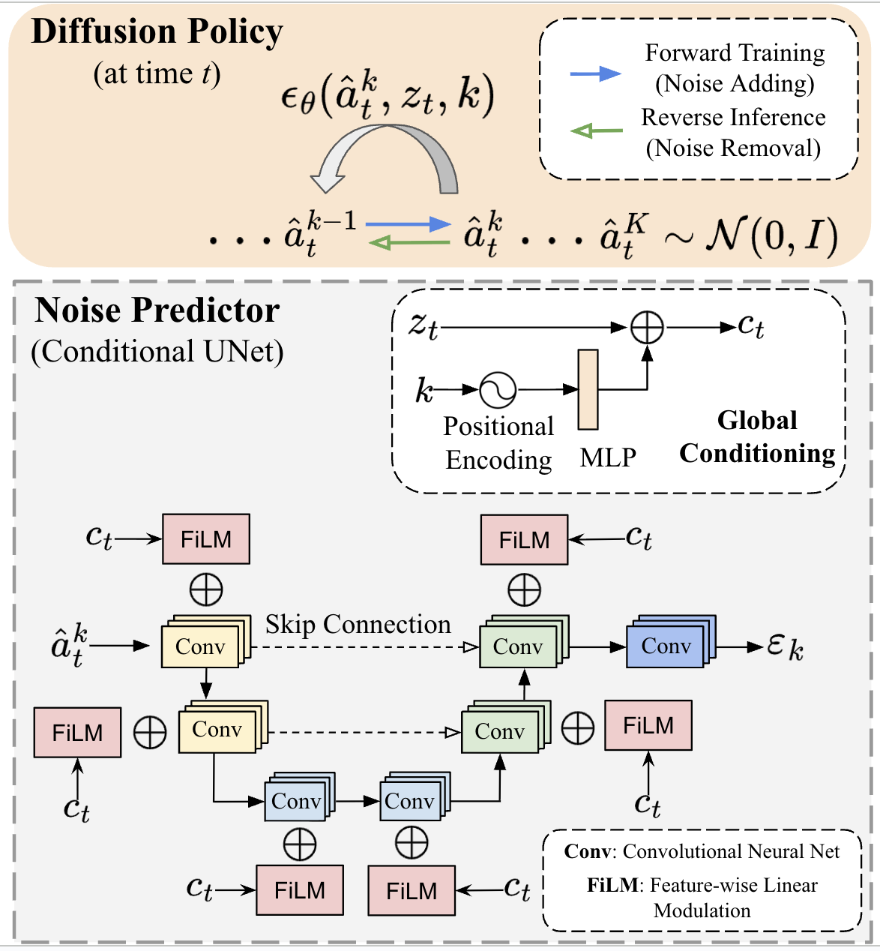
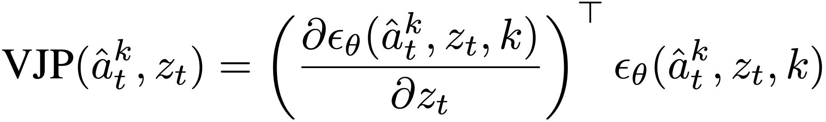

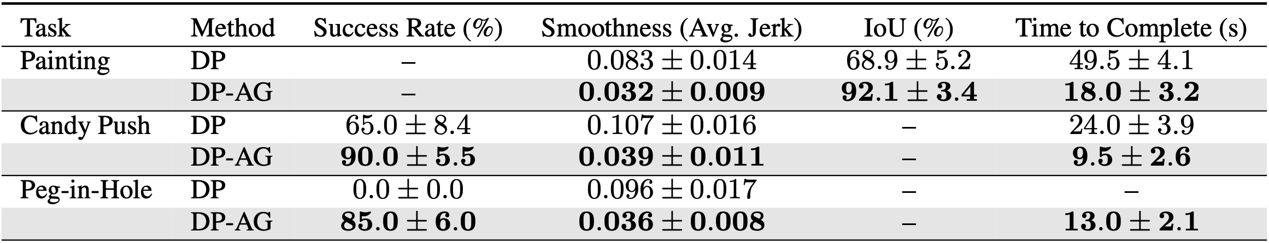
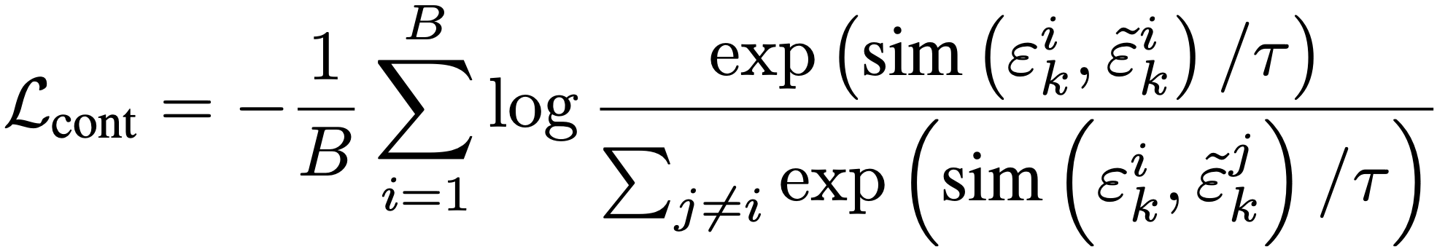
Diffusion-Driven Perception-Action Interplay
for Adaptive Policies
Jing Wang¹, Weiting Peng², Jing Tang², Zeyu Gong², Xihua Wang¹, Bo Tao², Li Cheng¹
¹University of Alberta, ²Huazhong University of Science and Technology
Motivation
Experiments
Toy Experiment
Robots today act on static snapshots. They see once, decide once, and miss the chance to refine their understanding as they act.
Humans act and adjust simultaneously. Our actions continuously sharpen how we perceive the world.
We bring this principle to robots. Our DP-AG closes the loop between perception and action.
Simulation Benchmarks
observation representations in policy learning
From One-Time Seeing to Ongoing Interpretation
Benchmark | Success Rate
Push-T | 0.93 (i)/0.99 (k)
Dynamic Push-T | 0.80
Robomimic | 0.99
Franka Kitchen | 1.00
Encode Observation: Start from a sensor input. Instead of freezing these features, we represent them as uncertain latent variables.
Action Diffusion: A diffusion policy proposes actions by progressively denoising noise into smooth action sequences.
Action Feedback to Interpretation: Each action refinement back into the latent features via VJP-guided updates.
Cycle Consistency: contrastive loss keeps interpretation and action aligned.
Real-World Deployment on UR5

